Slide 1


GRADUATION THESIS Analysis, 3D modeling and dynamic simulation of the vehicle steering system in the VIOS car.
HO CHI MINH UNIVERSITY OF TECHNOLOGY FACULTY OF TRANSPORTATION ENGINEERING DEPARTMENT OF AUTOMOTIVE AND ENGINE
Instructors : PhD. Ngô Đắc Việt
Ph.D Trần Đăng Long
Name: Trịnh Tiến Long
Student ID: 1852047

Slide 2
I. Introduction
II. Implementation Process
Contents
III. Results - Discussions
IV. Conclusion - Recommendation

Slide 3
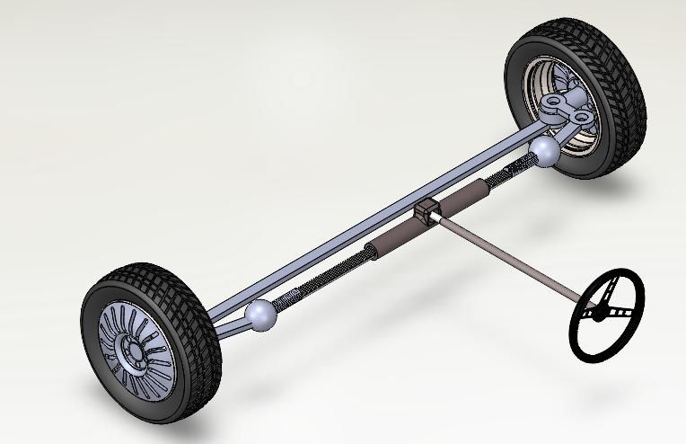
I. Introduction:
Objective of this thesis:
1. To build a dynamic model of Toyota VIOS steering system using MATLAB Simscape Multibody
2. To calculate the relationship between steering wheel effort and steering wheel angle upon vehicle speed and weight
Reasons for this thesis:
_ Build 3D model of the steering system on Solidworks then import to Simscape to determine the torque acting on steering wheel with certain steering angle on EPS system
_Simulation of dynamic behavior in Matlab/Simulink with Simscape
_Validation the model for the control of an equivalent electric powered steering system
Notes:
This table outlines the scope of implementation and mission summary for a project related to the steering system. The focus is on lower speed vehicles. The mission involves building a 3D model of the steering system on Solidworks, importing it to Simscape to determine the torque acting on the steering wheel with a certain steering angle on the EPS system, simulating the dynamic behavior in Matlab/Simulink with Simscape, and validating the model for the control of an equivalent electric powered steering system.
Thêm video minh hoạ
Thêm slide kiểm tra động học quay vòng

Slide 4
I. Introduction:
The problem that needs to be solved.
Build 3D model of Steering System on Solidworks with parameters based on VIOS car at HCMUT Automotive Workshop
Link the model to Simulink Simscape and ensure that it is valid and functioning properly.
Prepare test cases for the steering system, including scenarios for changing the speed of the vehicle while steering from left to right, as well as lane-changing maneuvers.
To do that, we need to :
Build 3D model of Steering System on Solidworks with parameters based on VIOS car at HCMUT Automotive Workshop
Link the model to Simulink Simscape and ensure that it is valid and functioning properly.
Prepare test cases for the steering system, including scenarios for changing the speed of the vehicle while steering from left to right, as well as lane-changing maneuvers.
The result that needs to be achieved.
Synthesis of a process of simulating a steering system using Simscape Multibody.
Analyze torque in – steering wheel angle relationship from above cases
Notes:
This table outlines the problem that needs to be solved, which involves building a 3D model of the Steering System on Solidworks based on VIOS car parameters at HCMUT Automotive Workshop, linking the model to Simulink Simscape, and preparing test cases for the steering system. The test cases should include scenarios for changing the speed of the vehicle while steering from left to right and lane-changing maneuvers. The desired result is a process of simulating a steering system using Simscape Multibody and analyzing the torque-steering wheel angle relationship from the test cases.

Slide 5
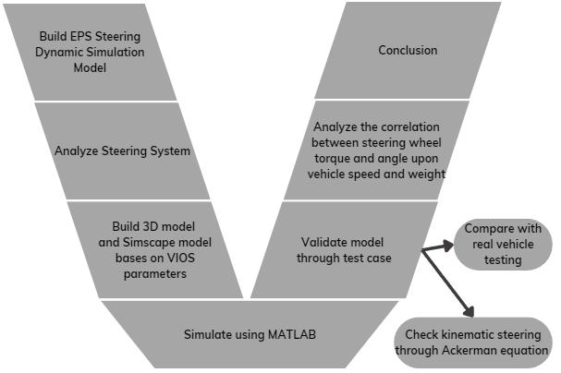
II/ Implementation process
Figure : Process V model

Slide 6
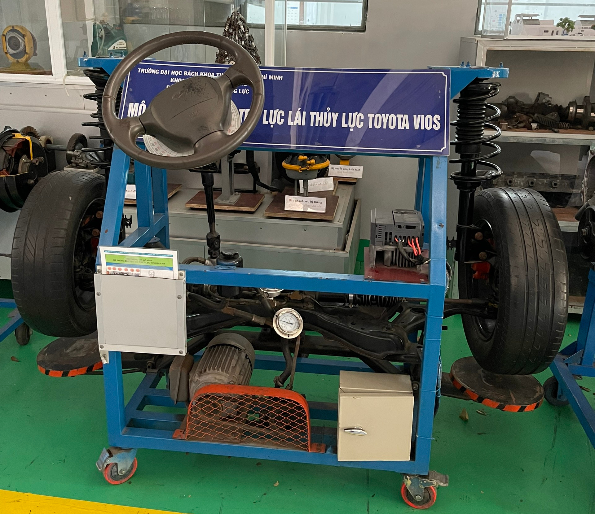
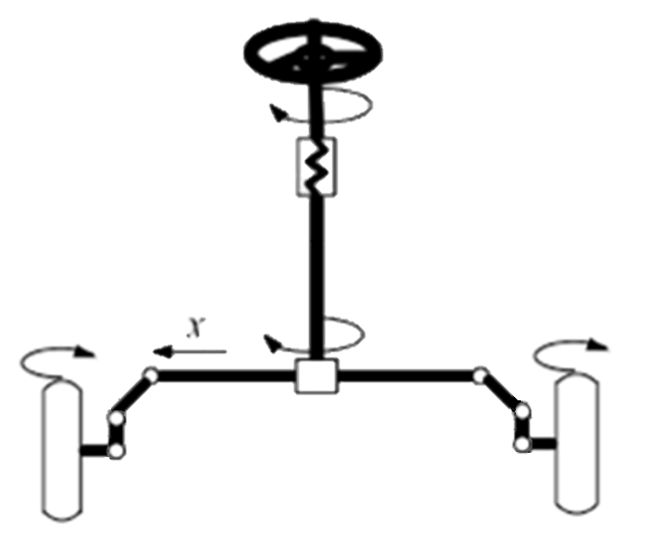
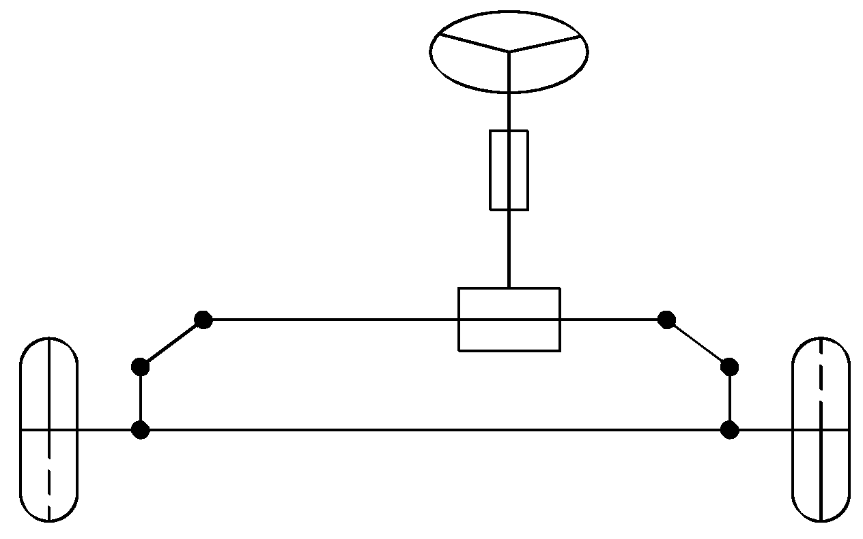
II/ Implementation process
Number of joints: 10
Number of linkage: 12
Figure : Process to build 3D model
Notes:
The steering system is designed to ensure proper kinematic turning of the vehicle.
The aim of this project is to simulate a steering system based on the parameters of a Toyota Vios car, in order to further study this mechanism.
Biểu diễn thông số trên 3d
+ sơ đồ nguyên lý khâu khớp
+ hình mô hình vios
Hình chụp -> khâu khớp -> 3d
Bao nhieu khớp, loại gì? -> Hình 3d tách ra
Thêm pt động lực học(trong tập)

Slide 7
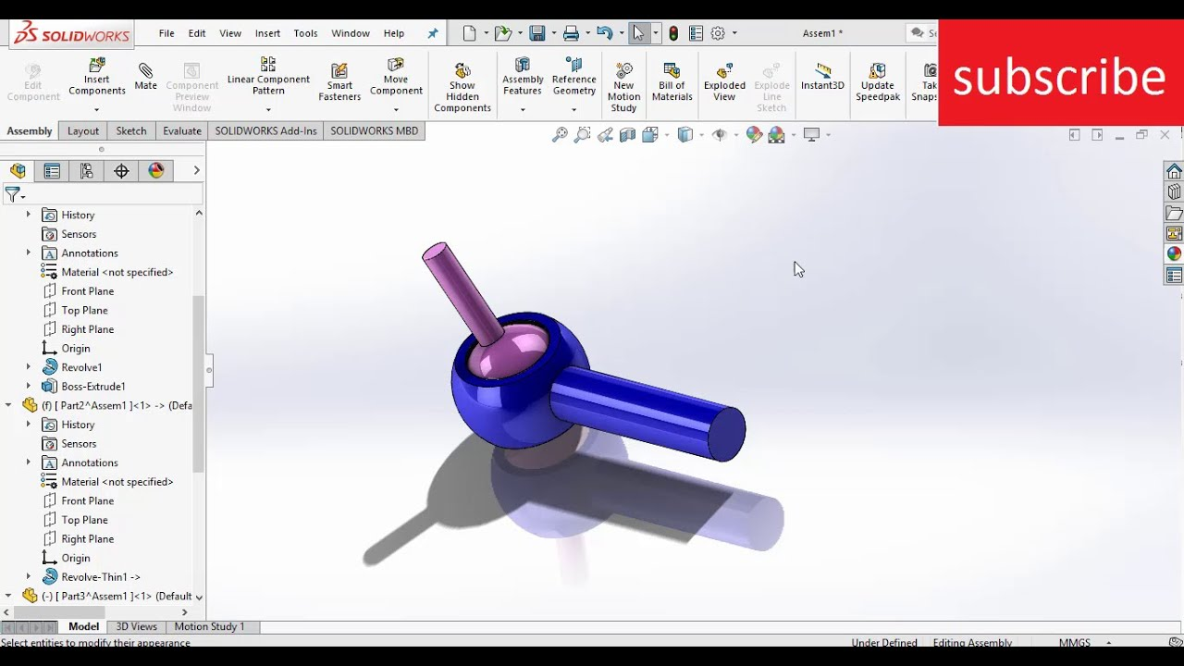
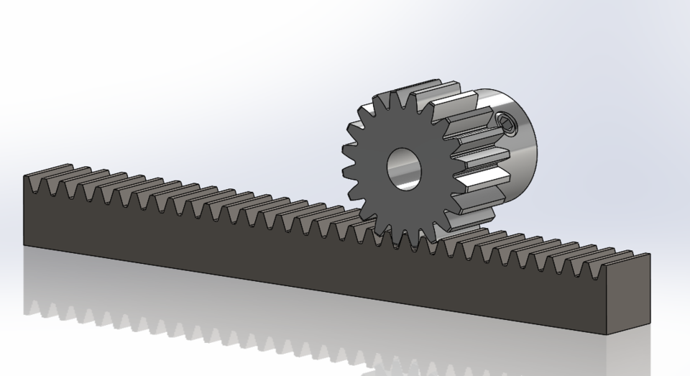

Slide 8
Notes:
them slide gthich rang buộc bên solid (khớp cầu, trượt, rack & pinion) – các bước thực hiện
Quy tắc yêu cầu?

Slide 9

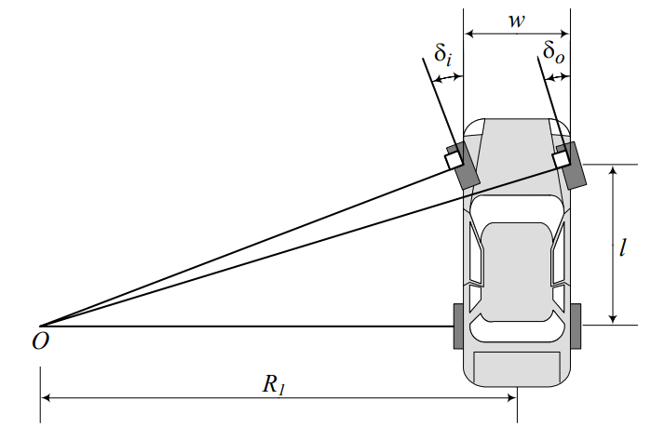
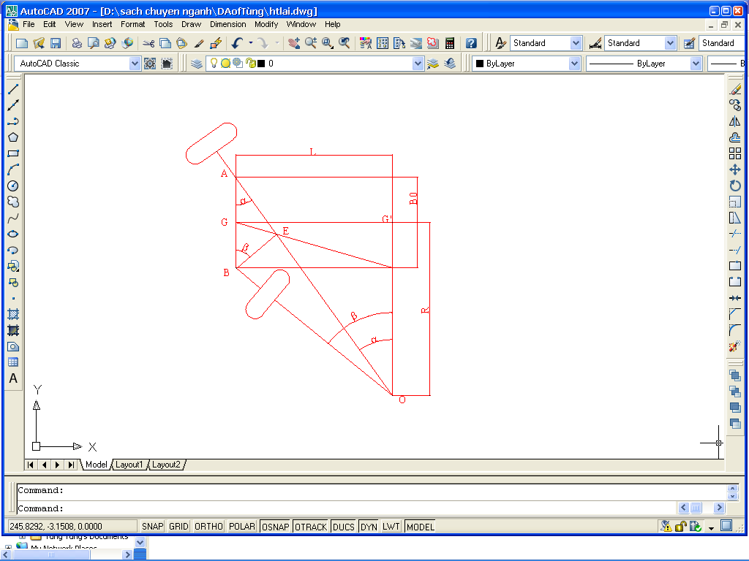
II. Implementation process :
Kinematics of the steering trapezium
Checking by algebraic method
Figure: A front-wheel-steering vehicle and the Ackerman condition
Notes:
Firstly, to make sure the model is valid, I checked the kinematic equation of steering by using algebraic method
β_{i}: the turning angle of the inner steering wheel (degrees);
δi: the turning angle of the outer steering wheel (degrees);
L: the wheelbase of the vehicle (mm);
B₀: the track width of the vehicle (mm
The algebraic method evaluates the degree of lateral slipping through the coefficient δi, which is determined by the following formula

Slide 10
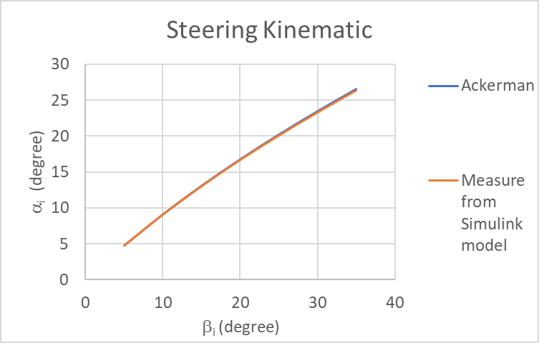
II. Implementation process :
Input: β_{i} (degree) | α_{i} from model (degree) | α_{i} (Ackerman) (degree)
5 | 4,75 | 4,76
10 | 9,07 | 9,09
15 | 13,03 | 13,07
20 | 16,69 | 16,74
25 | 20,1 | 20,18
30 | 23,31 | 23,42
35 | 26,38 | 26,51
Table : Calculation result
Notes:
For the cars currently in use, the oscillation coefficient δi is within the range of δ = 0.9 to 1.07????. Therefore, based on the calculation results, it can be seen that the steering trapezium of the vehicle, which has specifications similar to the Toyota Vios, ensures that the turning condition is met without lateral slipping.
Để vào apendix

Slide 11
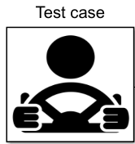
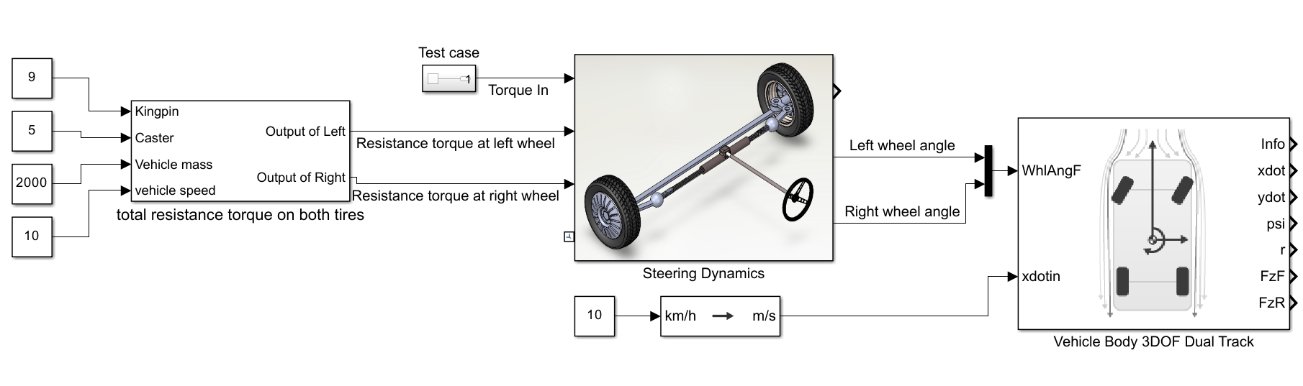
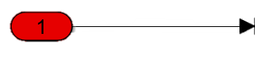
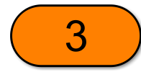


II/ Implementation process
1
2
3
Figure: Complete model
Notes:
Sửa lại thêm ng lái

Slide 12
II/ Implementation process
Notes:
Sửa lại thêm ng lái

Slide 13
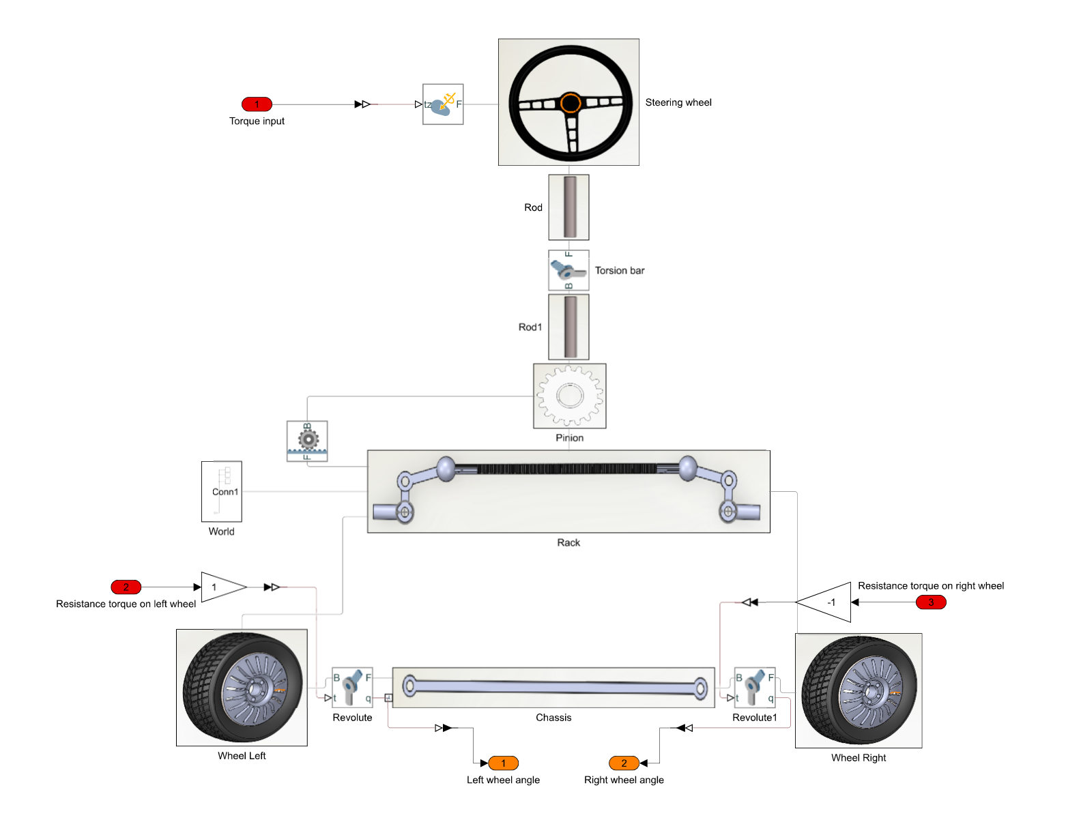
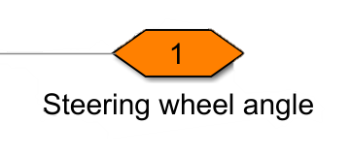
II/ Implementation process
3
1
2
2
3
1
Figure: Steering Dynamic model
Notes:
This figure show the corresponding of Simscape environment with Mechanics

Slide 14
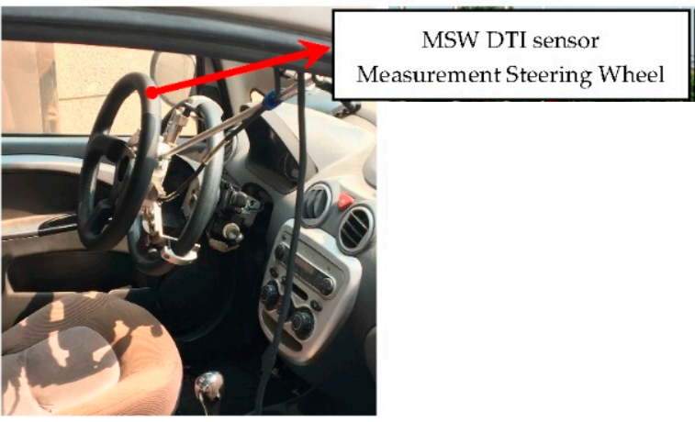
III/ Results and discussion:
1. Torque and Steering Angle relation at 1km/h and 5km/h for validation
Test cases
2. Steering Effort at different speed and weight
Figure : Real Vehicle Testing
Source: Study on Low-Speed Steering Resistance Torque of Vehicles Considering Friction between Tire and Pavement
Lane-changing scenario
Notes:
Measure steering torque, angle, and speed : MSW DTI sensor
the Correvit S-Motion DTI non-contact optical sensor measure speed, acceleration, angular rates, GPS position data and time, pitch, and roll angle during vehicle movement.

Slide 15
III/ Results and discussion:
Parameter table (based on VIOS car):
Parameters | Value
Vehicle mass | 1520kg (full load)
Caster | 5 degree
Camber | 9 degree
Source: Study on Low-Speed Steering Resistance Torque of Vehicles Considering Friction between Tire and Pavement

Slide 16
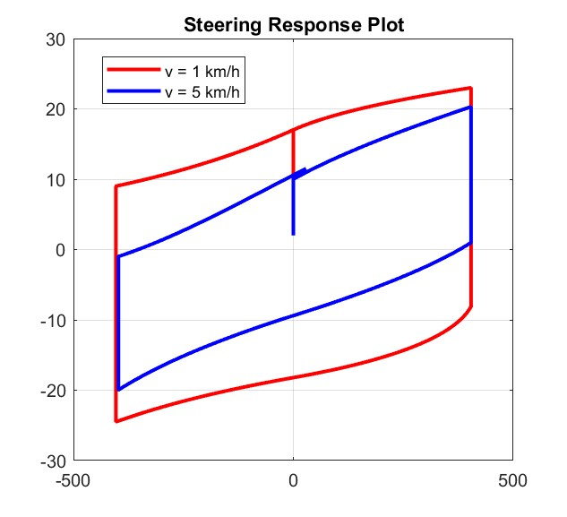
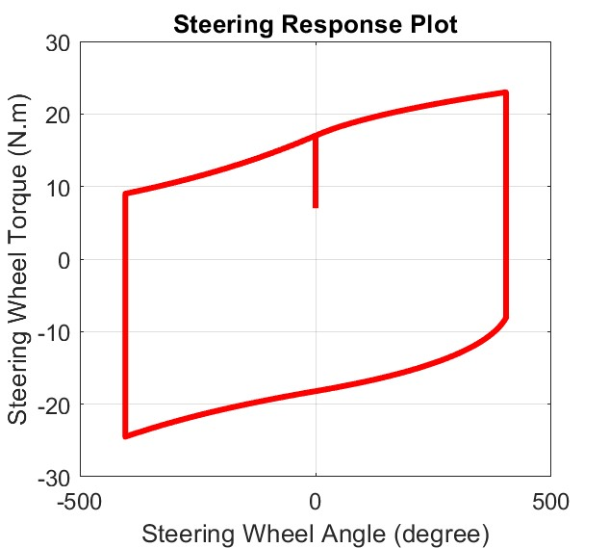
III/ Results and discussion:
Comparison between 1km/h and 5km/h
Notes:
let's compare the simulation results at 1km/h and 5km/h. We can see that less torque is needed to steer the vehicle at 5km/h compared to the 1km/h case.

Slide 17
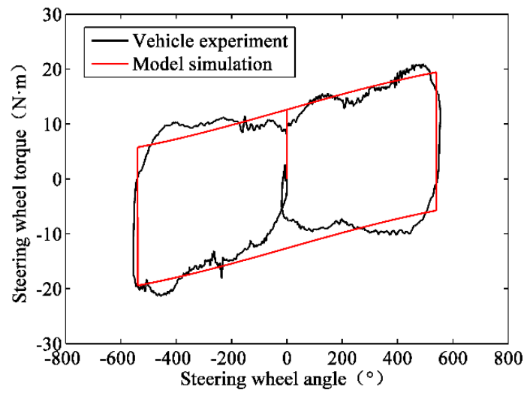
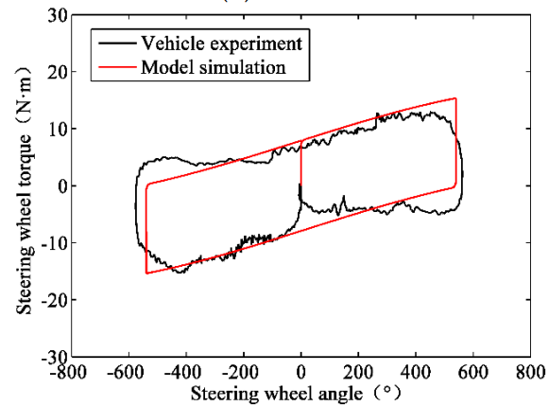
III/ Results and discussion:
Validation:
Real vehicle testing
a) V = 1km/h
b) V = 5km/h
Operating condition : v =1300kg, caster angle : 5 degree, camber angle : 9 degree
Source: Study on Low-Speed Steering Resistance Torque of Vehicles Considering Friction between Tire and Pavement
Notes:
When the speed is 5 km/h, we can see from the data that the size of the parallelogram is smaller than at 1 km/h in both diagrams.

Slide 18
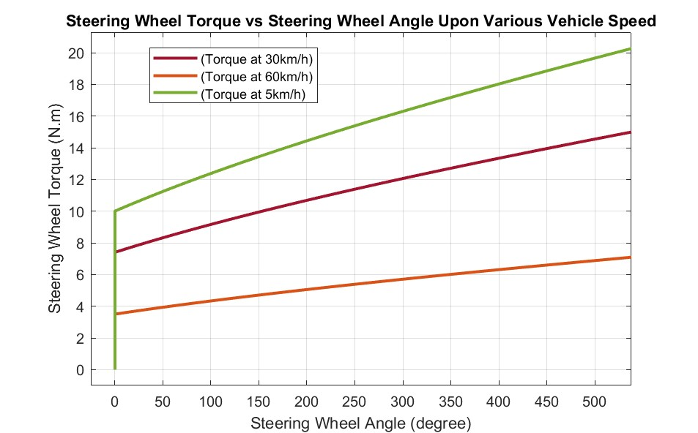
III/ Results and discussion:

Slide 19
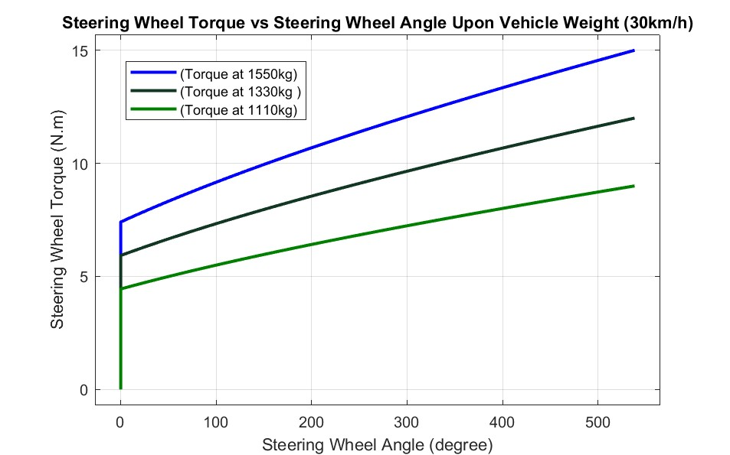
III/ Results and discussion:

Slide 20
IV/ CONCLUSION AND FUTURE PLAN
1. Model is valid due to the same behavior while comparing with real model from “Study on Low-Speed Steering Resistance Torque of Vehicles Considering Friction between Tire and Pavement”
2. Through all the figures mentioned above, we can conclude that steering torque needed decreases when speed increases
3. Steering wheel torque needed to finish a lane-changing maneuver reach 25N.m so we need assistance from motor to reduce the steering effort
The results obtained:
Steering effort will decrease when vehicle speed increases
Notes:
In conclusion, the objective of building and validating an EPS model using Solidworks and Simscape, and simulating its dynamic behavior in Matlab/Simulink with Simscape has been achieved. In order to improve the accuracy of the model, it is recommended to remove limitations in future testing and experimentation. Despite the limitation of the parameters based on the VIOS vehicle, the study demonstrates the potential of simulation models in optimizing vehicle control systems.
Đánh số 1,2,3 giống mục tiêu đề ra

Slide 21
V/ REFERENCE
Cossalter, Vittore. Motorcycle Dynamics. Lulu, 2010.
Genta. The Automotive Chassis. Springer International Publishing, 2020.
Hiremath, R. R., and Isha, T. B. “Modelling and Simulation of Electric Power Steering System Using Permanent Magnet Synchronous Motor.” IOP Conference Series: Materials Science and Engineering, vol. 561, no. 1, 2019, p. 012124, doi:10.1088/1757-899X/561/1/012124.
Jazar, Reza N. Vehicle Dynamics: Theory and Applications. Springer, 2008.
Nasir, M. Z., et al. “Hardware-in-the-Loop Simulation for Automatic Rack and Pinion Steering System.” Applied Mechanics and Materials, vols. 229-231, 2012, pp. 2135-2139, doi:10.4028/www.scientific.net/AMM.229-231.2135.
Nemes, Radu-Octavian, et al. “Integration of Real-Time Electric Power Steering System MATLAB/Simulink Model into National Instruments Veristand Environment.” 2018 IEEE 18th International Power Electronics and Motion Control Conference (PEMC), 2018, doi:10.1109/epepemc.2018.8521888.
Pacejka, Hans B. Tyres and Vehicle Dynamics. Butterworth-Heinemann, 2002.

Slide 22
V/ REFERENCE
Qun, Zhang, and Juhua, Hu. “Modeling and Simulation of the Electric Power Steering System.” 2009 Pacific-Asia Conference on Circuits, Communications and Systems, 2009, doi:10.1109/PACCS.2009.67.
Ingale, Amol. “Modeling Mass-Spring-Damper System Using Simscape.” Journal of Engineering Research and Application, no. Preprint, no date, doi:10.9790/9622-0801033033.
Sh., A., H., E., and A., E.-H. “Side-Stick Control of Power Rack and Pinion Steering System.” The International Conference on Applied Mechanics and Mechanical Engineering, vol. 12, no. 12, 2006, pp. 383-396, doi:10.21608/amme.2006.41261.
Setiawan, A. and Baharom, M. R. "Development of Force Feedback in Steering Systems: A Review." Journal of Mechanical Engineering and Sciences, vol. 9, no. 1, 2015, pp. 1573-1586, doi:10.15282/jmes.9.1.2015.12.0147.
Tuan, N. A., and Thang, N. V. "Determining the Vertical Force When Steering." Journal of Science and Technology, vol. 55, no. 3, 2017, pp. 7-14, doi:10.15625/2525-2518/55/3/9129.

Slide 23
V/ REFERENCE
Nguyen, V. H., et al. "Study on Low-Speed Steering Resistance Torque of Vehicles Considering Friction between Tire and Pavement." Journal of Mechanical Engineering Research and Developments, vol. 41, no. 4, 2018, pp. 51-60.
"Front Steering Gear Link." Toyota Vios / Soluna Vios, Japan Parts EU, 2010, http://www.japan-parts.eu/toyota/gr/2010/vios-soluna-vios/ncp42l-eepskr/2_149310_015/powertrain-chassis/4505_front-steering-gear-link/1.
Huu, Nguyen Ngoc and Quang, Tran Ngoc. "Real-Time Simulation of Electronic Power Steering System on TOYOTA VIOS." Proceedings of the 2nd Annual International Conference on Material, Machines and Methods for Sustainable Development (MMMS2020), edited by Bui Trong Long et al., Springer, 2021, pp. 273-281, doi:10.1007/978-3-030-69610-8_28.
Pang, Jong-Hyuk and Jang, Seong-Ho. "Steering Wheel Torque Control of Electric Power Steering by PD-Control." International Journal of Automotive Technology, vol. 12, no. 3, 2011, pp. 391-397, doi:10.1007/s12239-011-0050-5.

Slide 24
V/ REFERENCE
Inallu, Prasanthi and Raju, G. Jaya Krishna. "Design of Steering Wheel Force Feedback System with Active Disturbance Rejection Control." 2018 International Conference on Circuit, Power and Computing Technologies (ICCPCT), 2018, pp. 1-5, doi:10.1109/ICCPCT.2018.8473152.
Sharma, R., Ganai, P., Pare, V., Kanchwala, H., Srihari, S.J. (2023). Validation of a Steering System Mathematical Model via Test Rig Measurements. In: Gupta, V.K., Amarnath, C., Tandon, P., Ansari, M.Z. (eds) Recent Advances in Machines and Mechanisms. Lecture Notes in Mechanical Engineering. Springer, Singapore. https://doi.org/10.1007/978-981-19-3716-3_13
Kang, Seung-Woo and Oh, Jung-Hwan. "Active Return-to-Center Control Based on Torque and Angle Sensors for Electric Power Steering Systems." International Journal of Automotive Technology, vol. 22, no. 6, 2021, pp. 1867-1874, doi:10.1007/s12239-021-0177-7.
Đặng, Quý. Tính Toán Thiết Kế Ôtô. NXB Hồ Chí Minh, 2001.

Slide 25

THANK YOU FOR
YOUR ATTENTION

Slide 26
III/ Results and discussion:
Test case 1 (1km/h)
Operating condition : v = 1km/h, steer full lock-to-lock
Source: Study on Low-Speed Steering Resistance Torque of Vehicles Considering Friction between Tire and Pavement
Notes:
Điều kiện vận hành của 2 xe có giống nhau không ???
Our goal is to turn the steering wheel all the way to the right, then to the left, and back to the center, which is called "full lock-to-lock". We started at a steering wheel angle of 0 degrees and simulated the process. The simulation results of 1km/h case shown on the left. We can compare these results to real car data when we change the vehicle speed later.

Slide 27
III/ Results and discussion:
Test case 1 (1km/h)
Source: Study on Low-Speed Steering Resistance Torque of Vehicles Considering Friction between Tire and Pavement
Notes:
Điều kiện vận hành của 2 xe có giống nhau không ???
Our goal is to turn the steering wheel all the way to the right, then to the left, and back to the center, which is called "full lock-to-lock". We started at a steering wheel angle of 0 degrees and simulated the process. The simulation results of 1km/h case shown on the left. We can compare these results to real car data when we change the vehicle speed later.

Slide 28
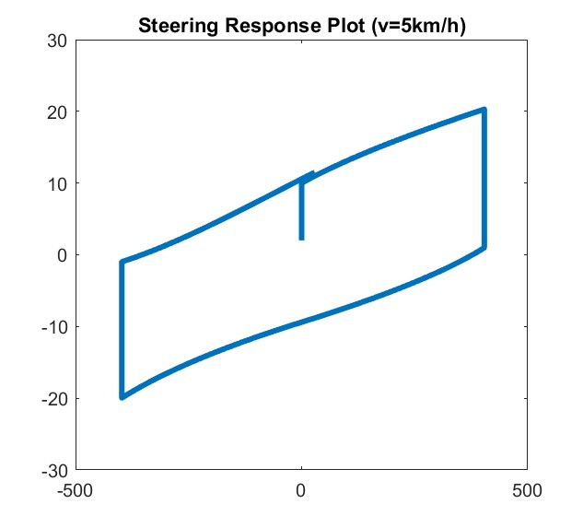
III/ Results and discussion:
Test case 1 (5km/h)
Operating condition : v = 5km/h, steer full lock-to-lock
Source: Study on Low-Speed Steering Resistance Torque of Vehicles Considering Friction between Tire and Pavement
Notes:
When the speed is 5 km/h, we can see from the data that the size of the parallelogram is smaller than at 1 km/h in both diagrams.

Slide 29
III/ Results and discussion:
Test case 1 (1km/h, 5km/h)
a) V = 1km/h
b) V = 5km/h
Operating condition : v = 1km/h, steer full lock-to-lock
Notes:
Điều kiện vận hành của 2 xe có giống nhau không ???
Our goal is to turn the steering wheel all the way to the right, then to the left, and back to the center, which is called "full lock-to-lock". We started at a steering wheel angle of 0 degrees and simulated the process. The simulation results of 1km/h case shown on the left. We can compare these results to real car data when we change the vehicle speed later.

Slide 30
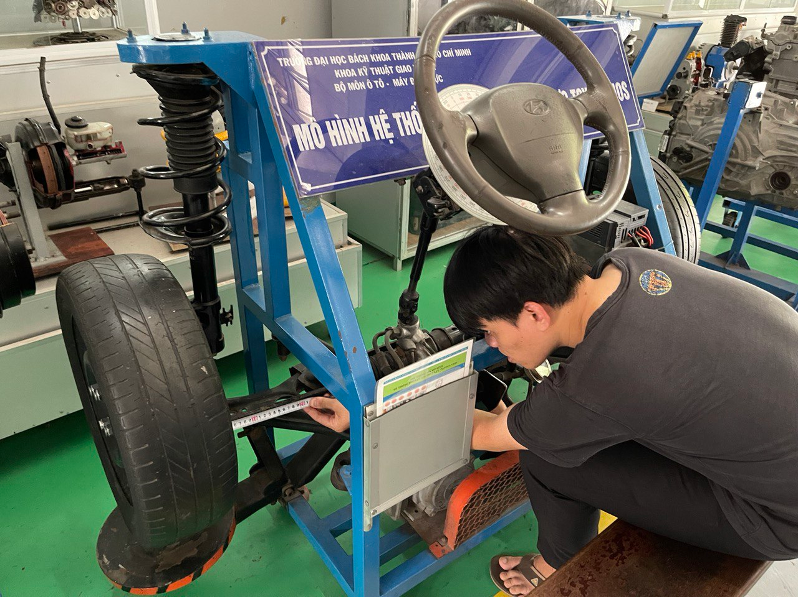
III. Parameter of model
Notes:
These parameters collect base on VIOS steering model at Automotive workshop

Slide 31
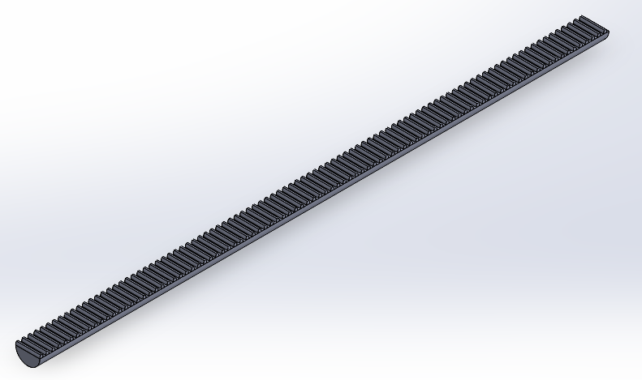
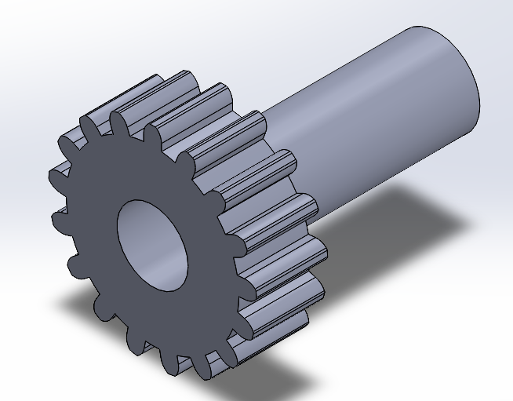
III. Parameter of model
2) Design of component:
Figure: Rack
Figure: Pinion
Notes:
Base on parameters above, models have been done using solidworks software

Slide 32
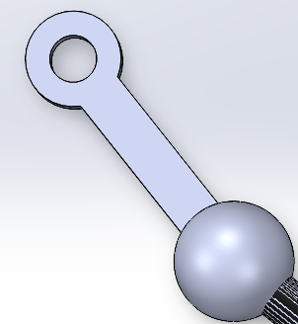
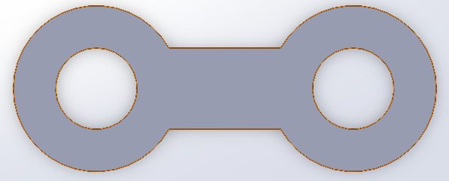
III. Parameter of model
2) Design of component:
Figure: Steering Linkage
Figure : Tie rod

Slide 33
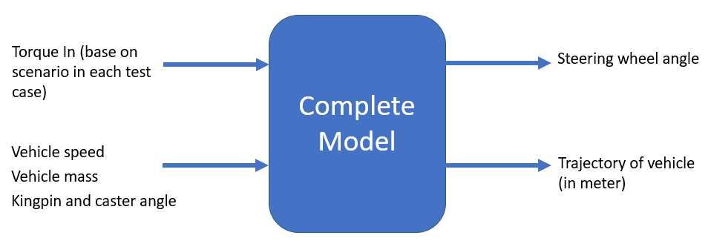
IV/ Implementation process
Figure: Operation Flow

Slide 34
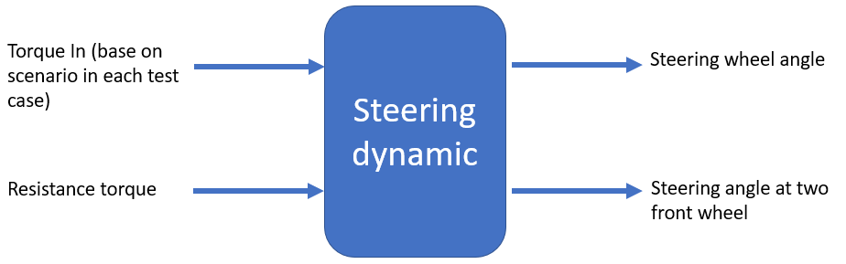
IV/ Implementation process
Figure: Operation Flow

Slide 35
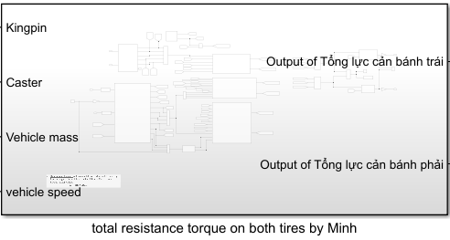
IV/ Implementation process
Figure: Total resistance torque

Slide 36
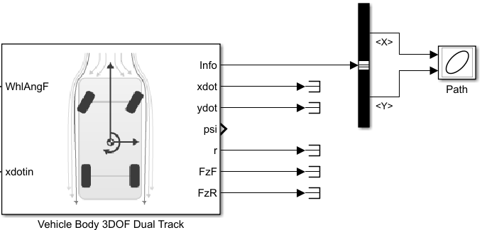
IV/ Implementation process
Figure: Vehicle Body 3DOF Dual Track

Slide 37
III. Parameter of model
1) Parameter table:
Rack | Pinion: Rack ratio | Track Width
0.37m | 1:3 | 1.4m
Tie Rod | Steering Linkage | Radius of steering wheel
0.265m | 0.1m | 180mm
Steering gear ratio | Number of teeth on the pinion | Number of teeth on the rack
19.5 | 9 | 27
Notes:
This table presents the specifications of the steering system, including Rack, Pinion, Tie Rod, Steering Linkage, Steering Gear Ratio, and other technical parameters. Specifically, the Rack-Pinion system has a Rack ratio of 1:3, a track width of 1.4m, Tie Rod has a length of 0.265m, Steering Linkage has a length of 0.1m, and the radius of the steering wheel is 180mm. The Steering Gear Ratio is 19.5, the number of teeth on the Pinion is 9, and the number of teeth on the Rack is 27. These parameters are crucial in designing and evaluating the performance of the steering system.

Slide 38
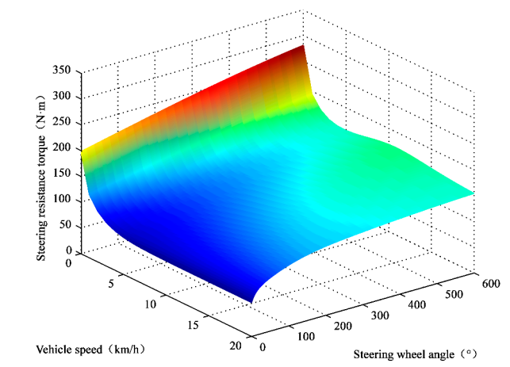

Slide 41
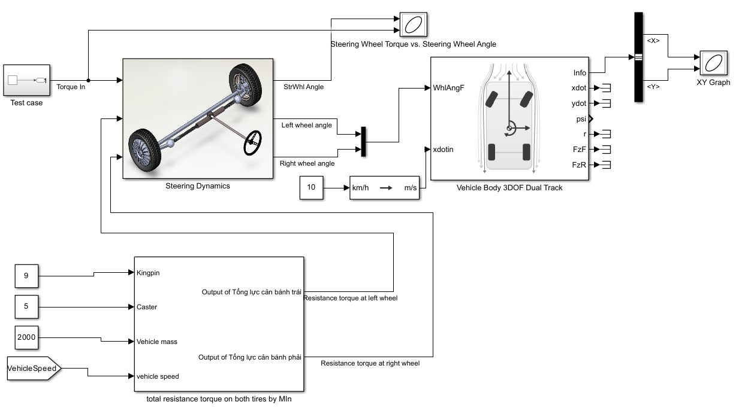
II/ Implementation process
1
2
3
Figure: Complete model
Notes:
Sửa lại thêm ng lái

